Slide 1

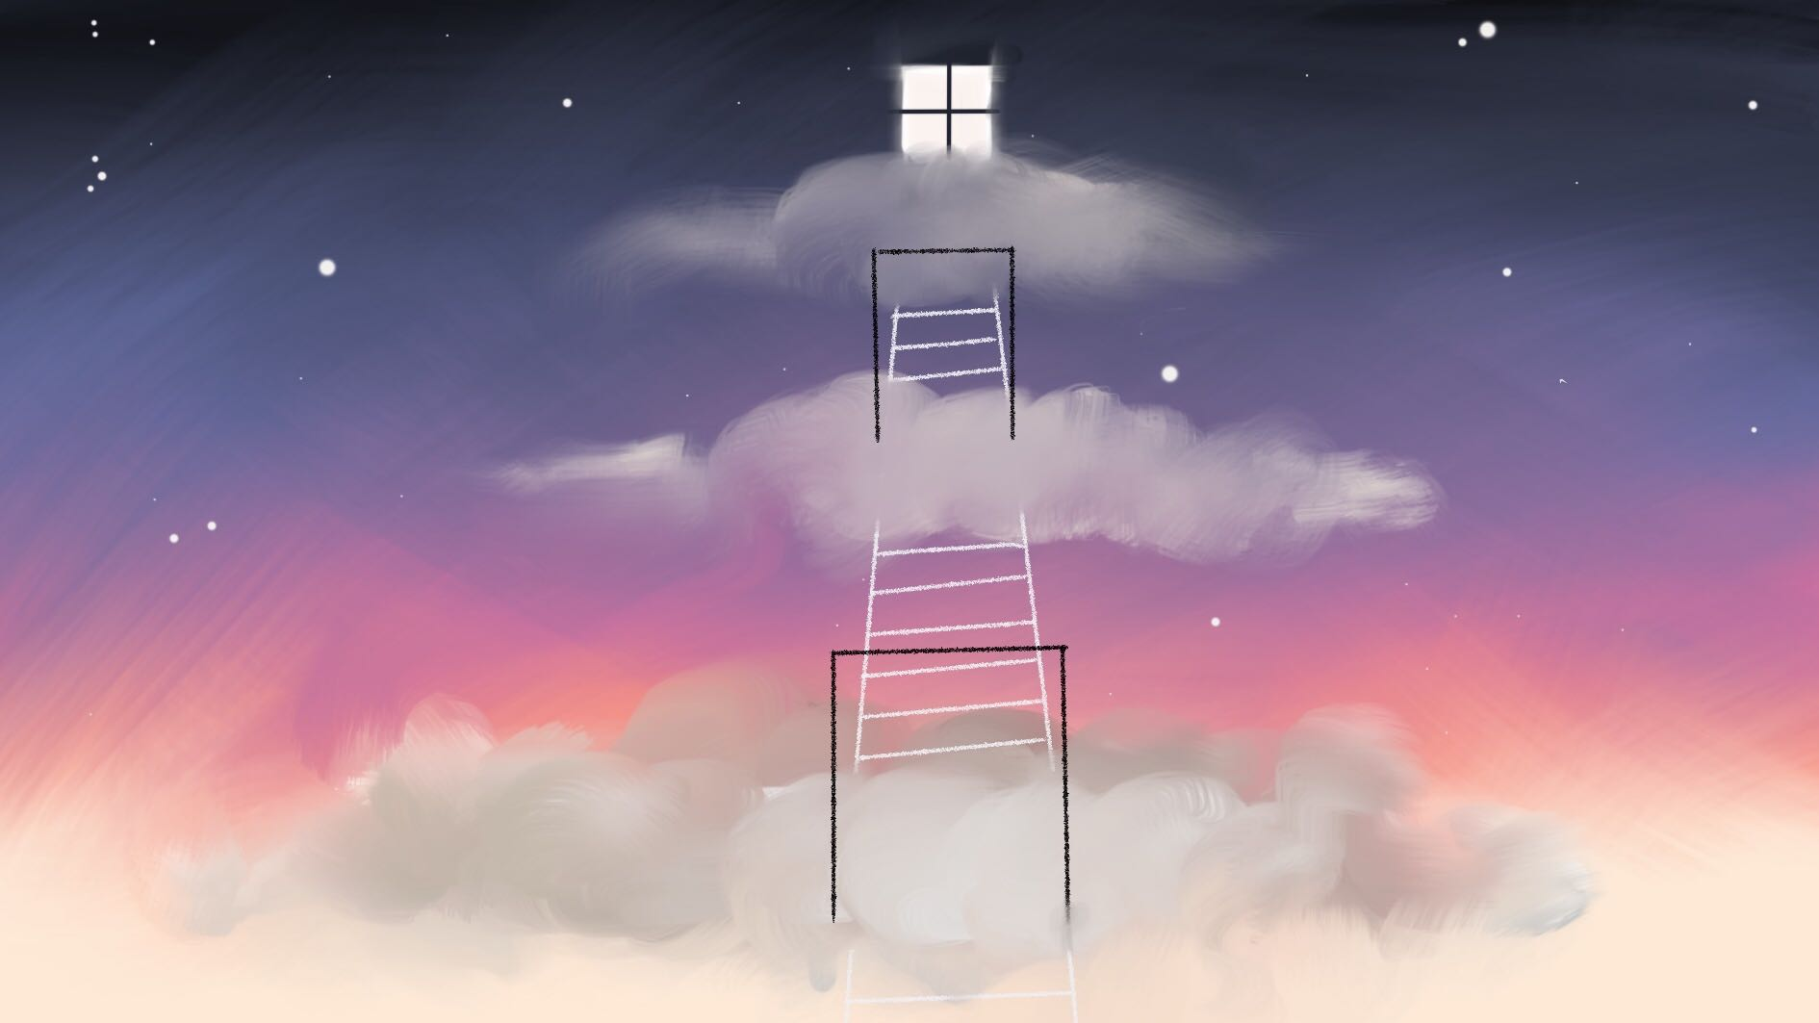
WHAT BECOMES OF THE BROKEN HEARTED?
- TEAM PROJECT HEART -
Collaborative project. Narrative Game. ST_2019

Slide 2
TEAM PROJECT HEART
IGNACIO
Writer & Designer
ALBA
Project Lead & Character Artist
FREDERYK
Programmer,
VFX & Music
MARIA
Environment Artist

Slide 3
Video 3min:
Quote playing out + showing anxiety
Showing lvl structure from above
Intersctions with sports water bottle & baseball bat showcasing flavor text
Emotion slide → showing characters “interact”
Mood progression slide playing

Slide 4
Inside Diego's Heart you, as his anxiety, are trying to process his past relationship either through using violence or patience to soothe his aggravated emotions.

Slide 5
Showing lvl structure from above

Slide 6
Intersctions with sports water bottle & baseball bat showcasing flavor text

Slide 7
Emotion slide → showing characters “interact”

Slide 8


Slide 9
ARTWORK

Slide 10
Video 2min:
Turnarounds of the characters
Speedmodeling/painting videos
Animation showcase in Unity

Slide 11
VIDEO
CHARACTERS

Slide 12
Video 2min:
Camera “flying” through all the levels in chronological order
Depending on what level/room is shown the concept art for said room is present in the rightbottom corner
Showcasing of some items (plants, creative furniture etc)

Slide 13
GAMEPLAY
ENVIRONMENTS

Slide 14
PROGRAMMING

Slide 15
Video 3min:
1) Speedrun of the first level in its complete entirety, starting on the cloud placeholder

Slide 16
DEMO
PROGRAMMING

Slide 17



* basic structure based on
presentations
= main objectives
*cluster of assets
* accessibility of most recent game build
* weekly ~sprints~
= small objectives
* quick feedback
* knowledge of what everyone is working on at all times
* lists of assets, mechanics, animations, sounds etc.
* summary of game ideas
* all resources available
* personal deadlines
PLANNING & EXECUTION

Slide 18
THANK YOU FOR LISTENING
Collaborative project. Narrative Game. ST_2019

